Slide 1

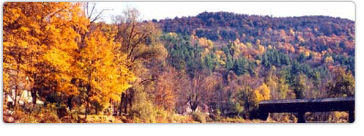

Raising Money for operations…
Do What Many Say is Not Possible
Michele R. Berard, MBA, CFRE
Executive Director
Butler Hospital Foundation, Providence, RI

Slide 2
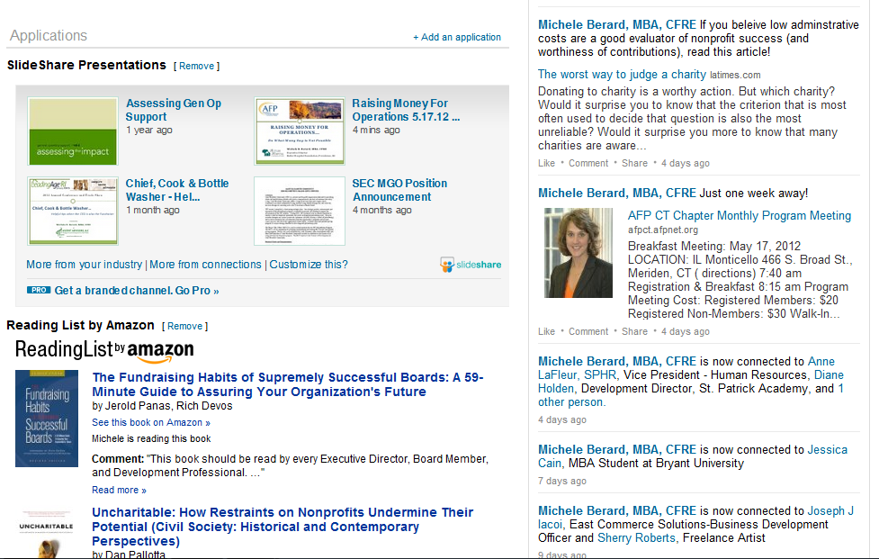

Slide 3

EXERCISE
  Why can’t we raise money for operations?

Slide 4
Agenda
Funding “operations” is a great investment
Shift your messaging
Identify fundable pieces (of your budget)
Obtain knowledge (knowledge is power)

Slide 5
Agenda Item #1
Funding “operations” is a great investment

Slide 6
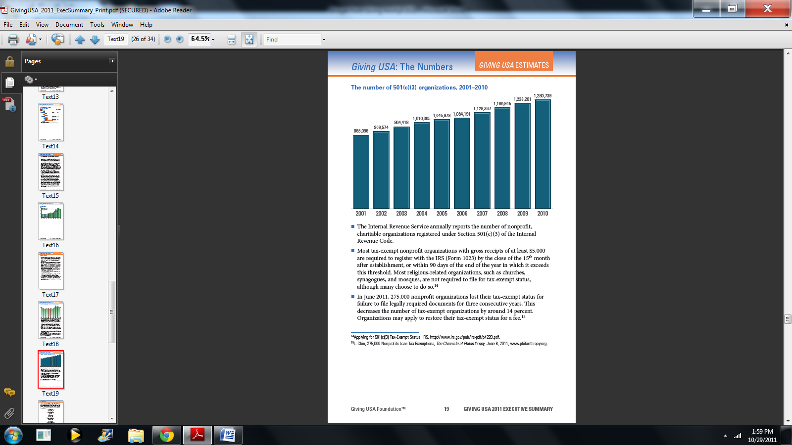
…from 865,096 to 1,280,739 in 10 years
Source: Giving USA 2011 The Annual Report on Philanthropy for 2010, Executive Summary

Slide 7
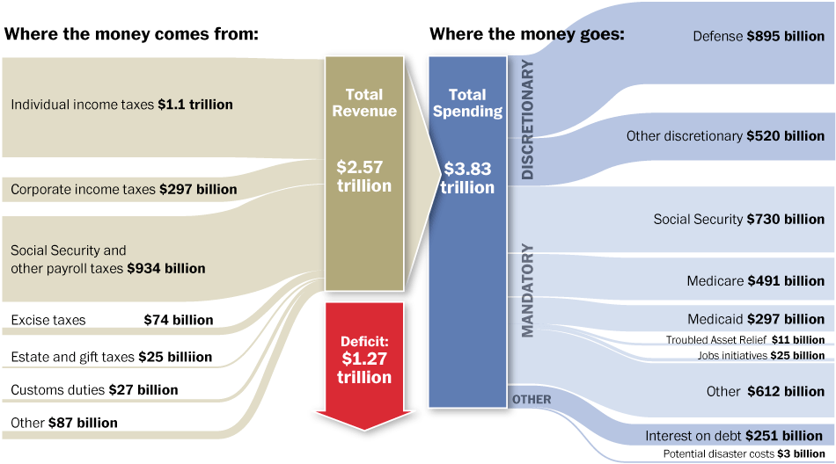
2011 Government Spending
Total revenue | $2.627 trillion (requested) $2.469 trillion (enacted)
Total expenditures | $3.729 trillion (requested) $3.796 trillion (enacted)
Deficit | $1.101 trillion (requested) $1.327 trillion (enacted)
Discretionary Spending (total $1.368 trillion) some line items:
Defense ($664b)
HHS ($79b)
Education ($46.7 b)
Homeland Security ($42.7 b)
and the list goes on…
(2010 spending-$3.55 trillion, 2012 spending-$3.8; $1.327 trillion deficit)
SOURCE: White House Office of Management and Budget; GRAPHIC: Wilson Andrews, Jacqueline Kazil, Laura Stanton, Karen Yourish The Washington Post

Slide 8
Why do Nonprofits Exist?

Slide 9
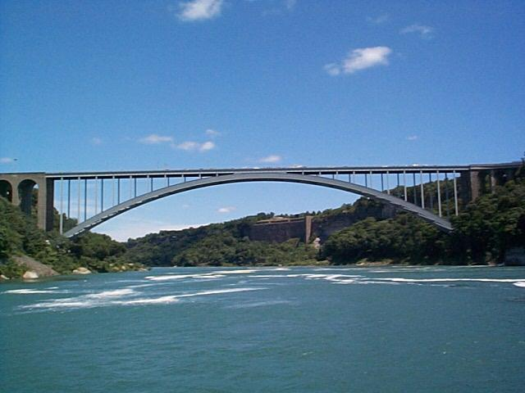
Why do Nonprofits Exist?
To bridge the gap between:
  Government
  Private Sector
Is the gap growing or shrinking?

Slide 10
Bridging Gaps for the Future
  What we know:
    # of Nonprofits have increased in the last decade
    Federal budget deficits continue to rise
    Private sector experiencing records profits
    What we can expect:
                Less government funding for non-profits
                More gaps in services; smaller government
                Opportunities for private sector…eventually
                Nonprofits bridging gaps…now

Slide 11
What is the Cost of Bridging Gaps?

Slide 12
What is the Cost of Bridging Gaps?
Hint: its your organization’s operating budget
Which is also your organization’s mission:
so…
Operating Budget = Mission = Bridge = Societal Solutions

Slide 13
Agenda Item #2
Shift your messaging

Slide 14
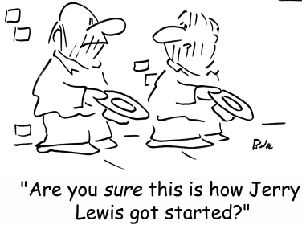
Internal Messaging = Motivation + Managing
Think:
Development is not a department
Air traffic Controller
Ally Acquisition
    Tactics:
    Staff Campaign
    Volunteer Campaign
    Grants Think Tank
    WIIFM
    Board Match
    “Friends of…” Group
    Executive Team Membership
    Coach Your E.D.
    Benchmarking
    Recognition/Tys
    Benefits of FR

Slide 15

Program Messaging = Mission
  Always Lead with Organizational Mission
    Leading with fundable attribute is “chasing the money”
      Pro = aligns with donor interests
      Con = dilutes the mission
    Donor stewardship is easier when mission components are related to the mission; donor pyramid
    Homework:
    Is your Organizational Case of Support at the forefront of all your requests?

Slide 16
Financial Messaging = Leverage
  Three ways organizations make money:
  Earn it
  Borrow it
  Raise it
  EXAMPLE: $19M Building Project
      Earn it - $6M
      Borrow it - $10M
      Raise it - $3M
  “…Every donor $ is being match 6.3x by the Hospital..”
  “…the Return on that investment will benefit you and your family when you need our services…”
    Homework:
    How is your organization leveraging donor “investments”?
Note: the statement above works better for unrestricted donations

Slide 17
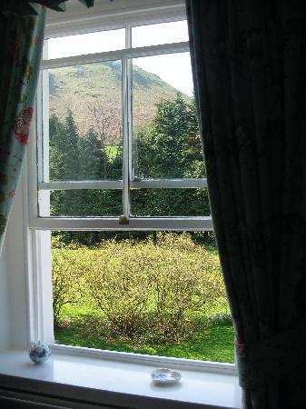
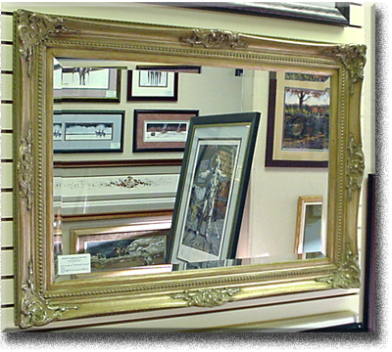
Community Messaging = Windows
  Windows not Mirrors
    E.g. Butler PAS Building Case:
      To meet the increasing demand for our services…
      Increase access to emergency healthcare in RI…
  SWOT Analysis = 360 degree evaluation
    Strengths & Weakness = internal
    Opportunities & Threats = external

Slide 18

INSPIRE, The Sharp HealthCare Campaign for Excellence, is a wide-ranging plan to provide San Diegans with ever-greater levels of quality care. This strategy will bring together the medical developments of the future and the talents of gifted physicians, clinicians and researchers.
We are dedicated to raising $100 million to support a $600 million plan to provide advancements at Sharp’s respected regional medical centers and specialty hospitals, from infrastructure and research to state-of-the-art technologies and the best possible patient care.
INSPIRE gives you the opportunity to support the aspects of health care that touch you most deeply. Our philanthropic priorities align with the greater goals of the organization to ensure financial support is available for critical areas of growth.
https://www.sharp.com/sharp-foundation/inspire.cfm

Slide 19

“…Through INSPIRE, donors have a unique opportunity to support the aspects of health care that touch them most deeply…
Enhance the level of caring for the people of our community
Promote learning that will mean better outcomes for patients
Underwrite the building of modern medical facilities
Encourage the growing and training of our own exceptional caregivers
Support Sharp in leading the way with new technologies and medical advancements…”
http://www.sharp.com/video/transcripts/inspire-campaign.cfm

Slide 20
EXERCISE
  SWOT Analysis :
  Identify general operating expenses that are taboo
  Conduct a SWOT Analysis for each one
  Strengths Opportunities
  Weaknesses Threats

Slide 21
Agenda Item #3
Identify Fundable Pieces (of your budget)

Slide 22
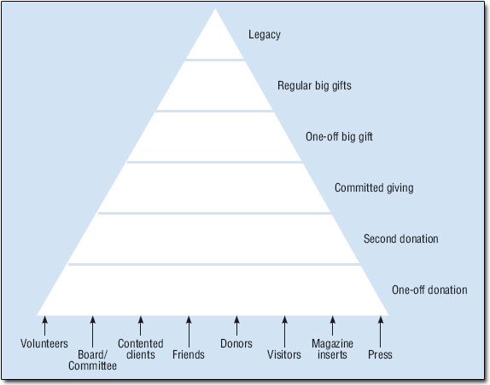
Quick Review – The Donor Pyramid
Objective: to match donor wishes with funding needs of the organization
Donor investment correlates with relationship
Multiple initiatives provide multiple opportunities:
  Discussions
  Allies
  Feedback
  investment

Slide 23
  Quick Review: Case for Support vs. Case Statement
    Case for Support – Why your organization exists; why people/donors should support your organization; what would happen if your organization did not exist
    Case Statement – Aligns a specific population to a specific program/project
    EXAMPLES:
      Corporate Campaign for Butler PAS Building
      Foundation Case Statement for PAS Building

Slide 24
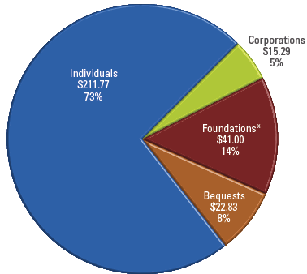
Align Donor Intent with Funding Needs
2010 Contributions:
$290.89 billion by giving source of contributions
Different funding streams contribute (or invest) for different reasons
Hint: start with funding needs of the organization, then work to align those needs to your constituencies
Source: Giving USA 2011 The Annual Report on Philanthropy for 2010, Executive Summary

Slide 25
Identify Your “Fundable” Initiatives
  Indentify Funding Needs of the Organization
    Budget
    Strategic Plan
    Money Losers & Money Winners
    Unmet Community Needs
    Talk (make an ally) with CFO…
  Identify Your Constituencies
    Individuals – identify all the entry points and relationships
    Foundations
    Corporations
    Government

Slide 26
Agenda Item #4
Obtain Knowledge (knowledge is power)

Slide 27
Diversify your Network
  Quality alignment depends on your knowledge
  Internal, External environments/trends/gaps
  Organizational Funding Needs (current and future)
    People outside of your organization
    Involvement in diverse networks
    Best Practices
    Embrace Opportunities for Peer Learning
    Wall Street Journal

Slide 28
Diversify your Network
  Get out of the office and interact with others
    AFP, CASE, AHP, PPP gatherings – Professional Associations
    Alumni Groups – Not only for Colleges (e.g. LRI)
    Chamber of Commerce Events – membership is not required
    Civic Clubs (Rotary, Lions, etc.)
    Sports – golf leagues, tennis, etc.
  The Internet
    Social Networking - LinkedIn – Groups, Facebook, Twitter
    E.g. Lenny Silva/Sovereign, Andre Savage/NWM, Stanford University
    AFP Open Forum (and other listserv groups)

Slide 29
EXERCISE
  You can raise money for operations!
  Why?
  How?
  What?

Slide 30
Your organization exists for a very good reason…
…your job is to find those individuals and stakeholders who need to see it continue
Fortune Cookie Saying:
“The greatest pleasure in life is doing something that others say is impossible”

Slide 31
My Contact Information:
Michele R. Berard, MBA, CFRE
Executive Director, Butler Hospital Foundation
Office: (401) 455-6565
Cell: (401) 263-4902
Email: mrberard@butler.org
Twitter: @micheleberard
LinkedIn: http://www.linkedin.com/in/micheleberard

